Slide 1
GREEN FIELD SOLUTION
Data Center I MEP I Interior Designing I Networking
Company Profile | 2025

Slide 2

01
02
03
Cover Letter
List of Projects
Business Verticals

Slide 3
Faizan Solanki
Sales Account Manager
faizan@greenfieldsolutions.tech

Slide 4
Cover Letter
01
Data Center Solutions provider

Slide 5
GFS was formed in 2005 with an objective to capitalize on the rising need of Data Center Infrastructure in the Kingdom. As of now GFS has expanded in the following Business Verticals
a. Data Center Turnkey Solutions
b. CCTV Surveillance Solutions
c. Structured Cabling
d. Electromechanical
e. Low Voltage Solutions
f. Low Current Solutions
g. Security Solution
h. Office Fit Out Works
i. Office Automation System
j. OSP / ISP (Outside plant / Inside Plant)
Right from incorporation GFS has always strived to be a knowledge base company and has focused in keeping a technically agile and versatile group of Engineers and Technicians who form the solid core of the company. Our team of Professionals has managed to keep the Quality of Service and the speed of execution very high. In this Profile, we will introduce you the Business Verticals we handle and also a list of a few projects recently executed will be detailed.

Slide 6
02
Business Verticals

Slide 7
CCTV Surveillance Solutions
a. Surveillance solution for high value assets.
f. Surveillance solution for malls.
e. Surveillance solutions for Masjids
c. Surveillance solution for crowd management
d. Surveillance solution for Residential areas.
b. Surveillance solution for military

Slide 8
Data Center Turnkey Solutions
Legacy Data Center
Modular Data Center
Container Data Center
Hybrid Data Center

Slide 9
Data Center to match the Uptime Institute or TIA Data Center Standards and for the ease of Identifying Business Solutions GFS has categorized these as Services which are as follows
Raised Floor & False CeilingSolution
Gypsum Partition Solutions | Fire Rated Doors & Glass
Fire Suppression System
Leak Detection & Monitoring Solutions |Alarm System (GSM, SMS & Email System)
Structured Cabling (Fiber & UTP)
Access Control System | CCTV
Air Precision Cooling Solution

Slide 10


Slide 11
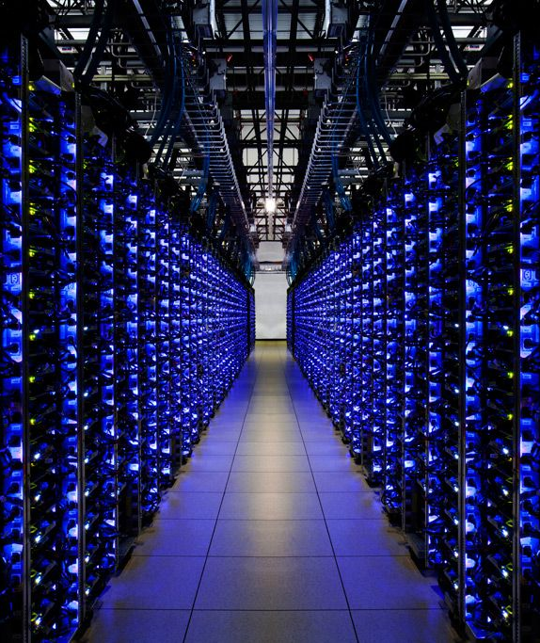
List of Brands
Which we work with

Slide 12
DATA CENTER

Slide 13














Slide 14
Low Current Solution

Slide 15
GFS has Expertise in designing State of the Art Security Solutions. Our Security Solutions has multiple Facets which suits both Government, Retail, Military, Residential and High Security Premises. Through years we have designed solutions for
Perimeter Protection system
Access Control System
On Premise Security
Public Area Protection

Slide 16









Slide 17
Structured Cabling

Slide 18
GFS has a concrete design approach for Structured Cabling Solutions, we follow EIA/TIA-568A Standards. Our design Considerations always take into consideration all the sub-elements in
Structured cabling
Backbone Cabling
Main Cross-connect (MC)
Interbuilding Backbone Cable
Telecommunications Closet (TS)
Equipment Room (ER)
Entrance Facility (EF)

Slide 19
Copper Cabling
UTP Cabling
STP Cabling
FTP Cabling
Coaxial Cabling
Fiber Cabling
Single Mode Indoor & Outdoor
Multi Mode
Indoor & Outdoor

Slide 20


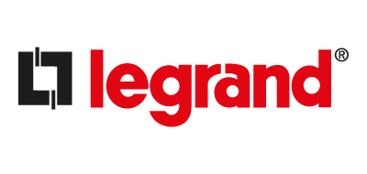






Slide 21
LIST OF PROJECTS

Slide 22
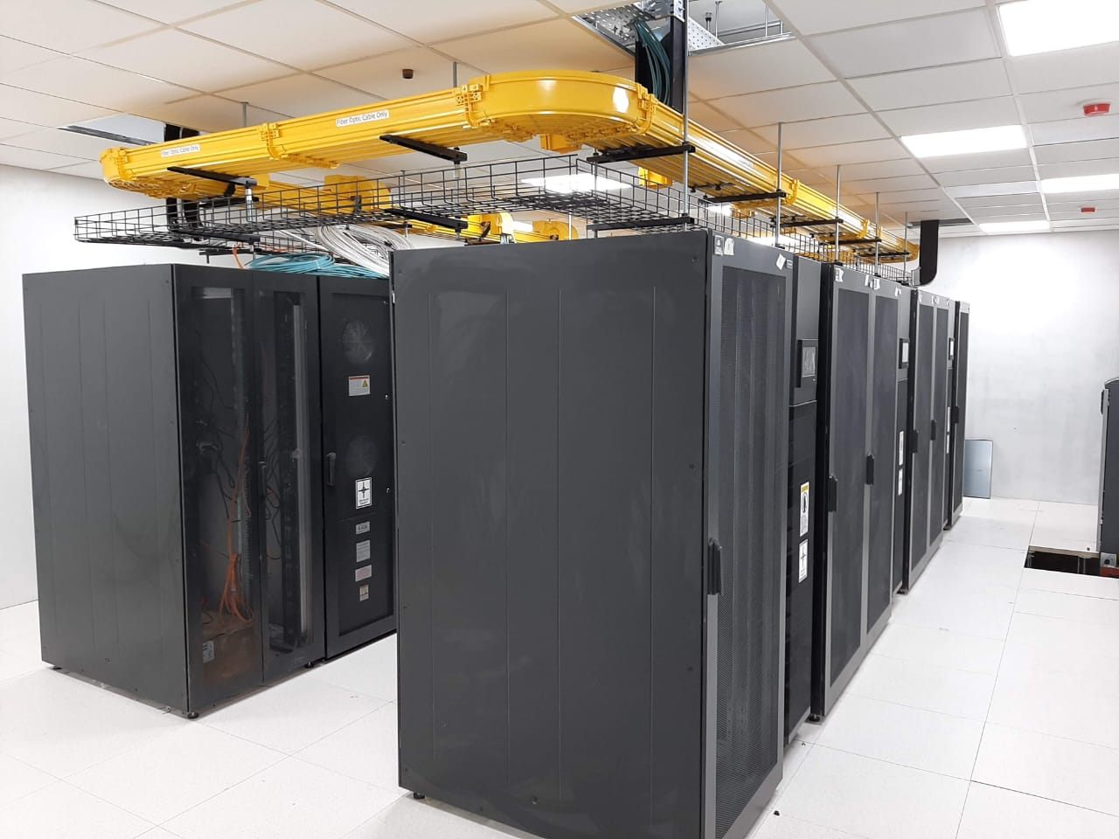
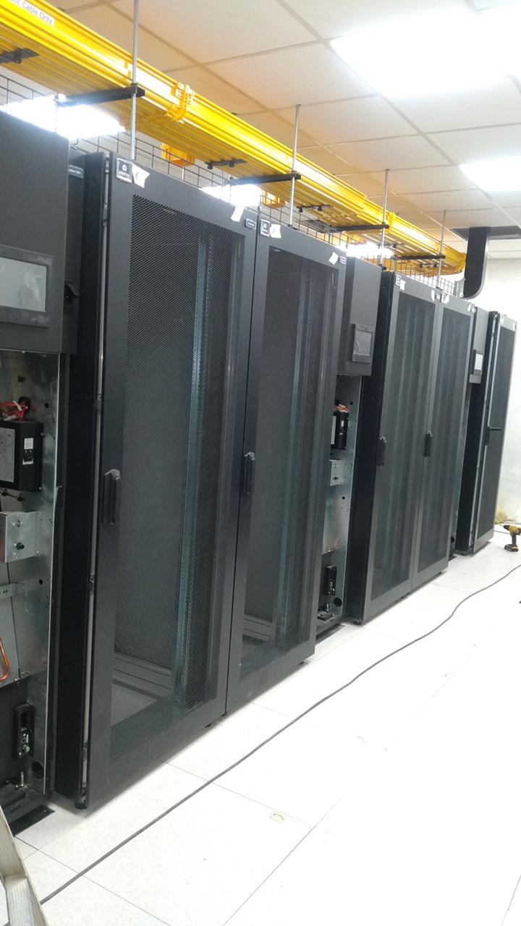
HOTEL DATA CENTER

Slide 23
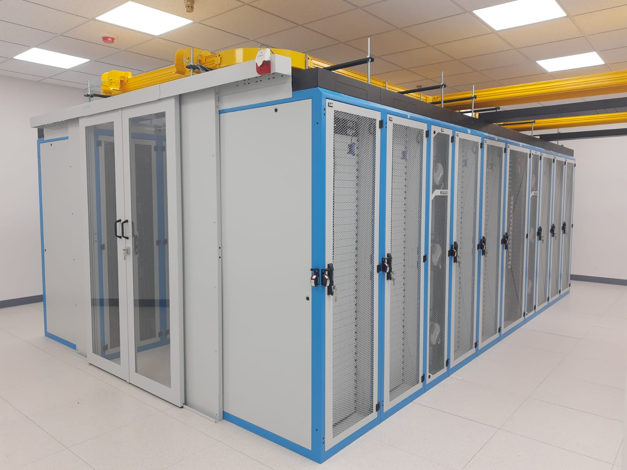
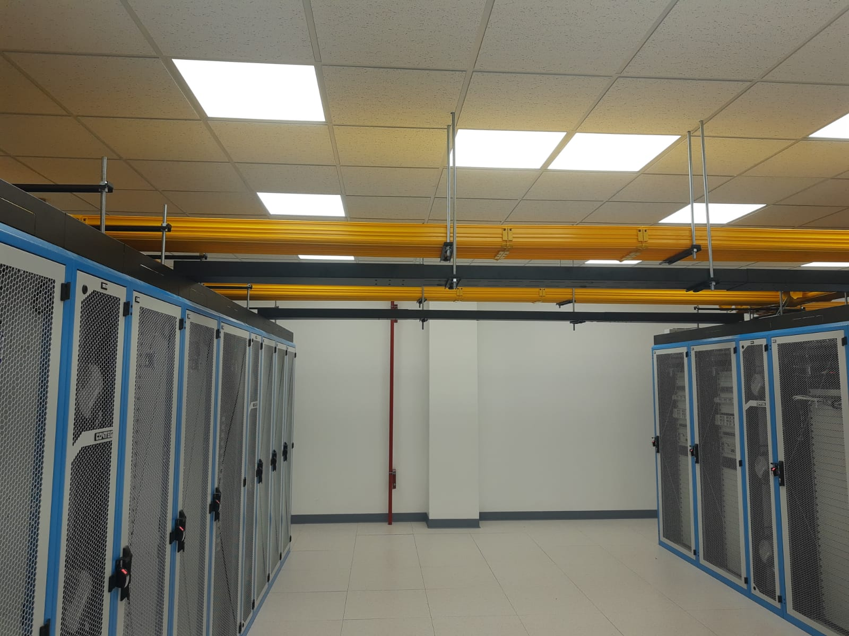
UNIVERSITY DATA CENTER

Slide 24
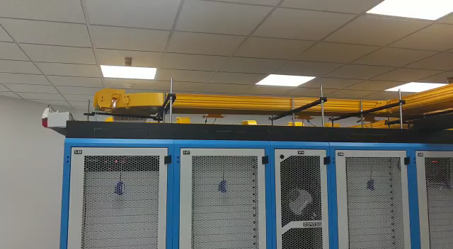

Slide 25
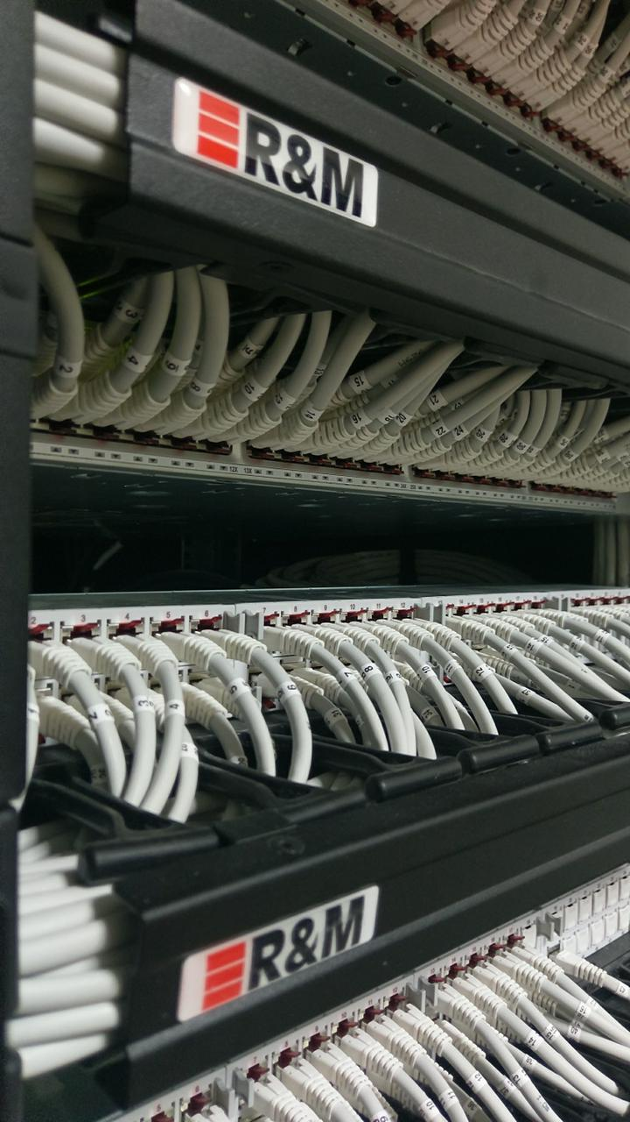
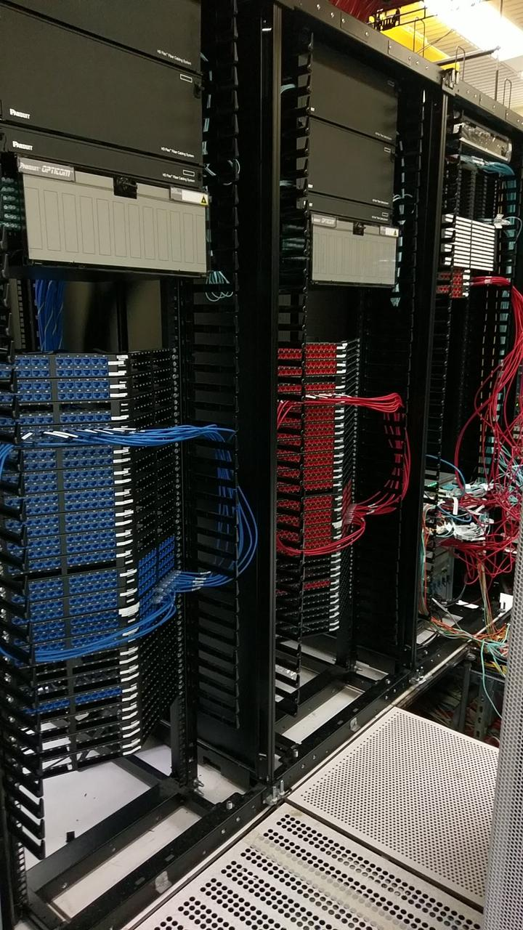
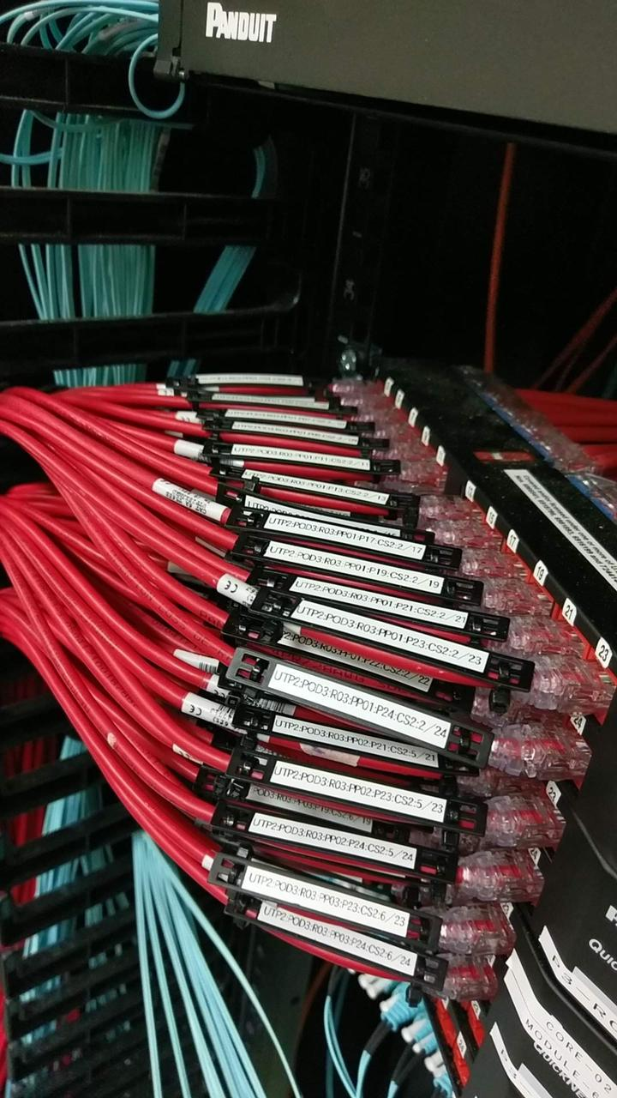
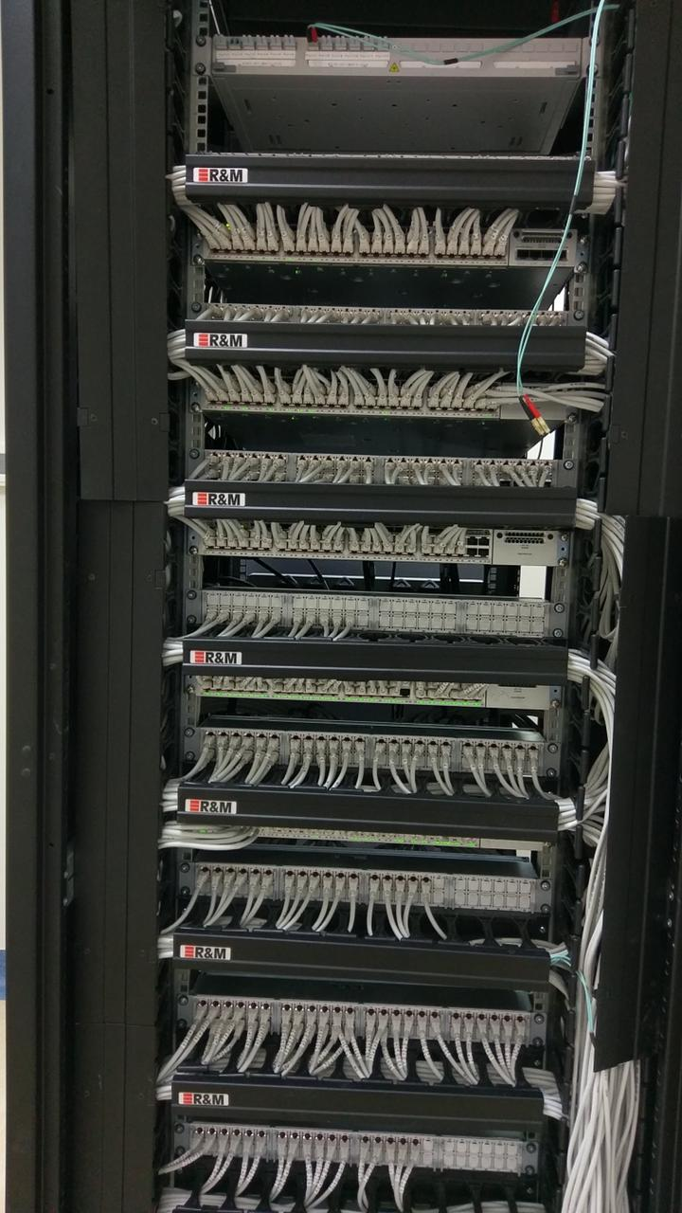
CABLING PROJECT

Slide 26
DATA CENTER
QUARA FINANCE
ROYAL COURT
ICT
MAKKAH BUS COMPANY
SECURITY SOLUTION
NCMS
HITACHI
KKU
MINISTRY OF DEFENSE
GOSI
MC DONALDS
ABB
HERFY
HIDA
PETRO RABIGH
NCMS
ABB FACTORY
DALLAH HOSPITAL
ERICSSON
SCHLUMBERGER
MC DONALDS
TOYOTA (ALJ)
MOBILY
ABB
KING KHALID MASJID
SAMAMA

Slide 27
THANKS!
Do you have any questions?
faizan@greenfieldsolutions.tech
+966 502976005

